Slide 1

MATH 5473 Project: Exploring Time-Series Data: Visualization, Clustering, and Topological Analysis with an SNP500 Case Study
Anastasiia KAZOVSKAIA, Songjie XIE, and Meiying ZHANG
08/05/2024

Slide 2
Outline
Introduction
Data Preprocessing
Visualization
Clustering
Topological analysis exploration
Conclusion
Math5473

Slide 3
Outline
Introduction
Data Preprocessing
Visualization
Clustering
Topological analysis exploration
Conclusion
Math5473

Slide 4
Introduction
In the modern financial landscape, the analysis of time-series data plays a crucial role in understanding market trends, predicting future movements, and making informed investment decisions.
Time-series data, characterized by its sequential nature and inherent variability, presents unique challenges in terms of analysis and interpretation. The time-series data, S&P500, is a widely recognized stock market index.
Our objective was to apply a combination of data visualization techniques, clustering methods, and topological data analysis (TDA) to extract meaningful insights.
Math5473
Notes:
3

Slide 5
Outline
Introduction
Data Preprocessing
Visualization
Clustering
Topological analysis exploration
Conclusion
Math5473

Slide 6
Dataset General Overview
The dataset, S&P500 , is a stock market index that tracks the performance of 500 large companies in the United States.
The finance dataset S&P500 contains 1258-by-452 matrix, which represents the closed price of stocks from 452 American company in 1258 consecutive workdays.
Math5473

Slide 7
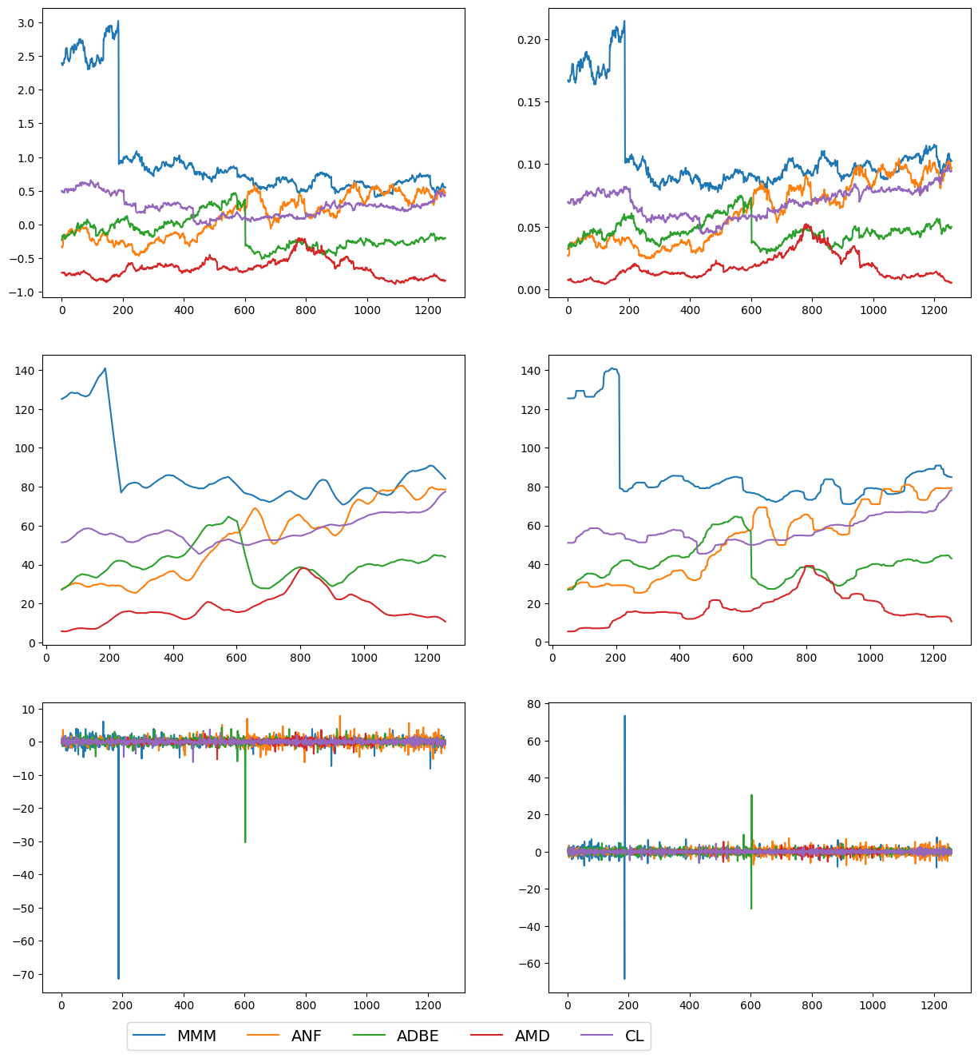
Dataset Preprocessing
We employed the following preprocessing techniques for time-series data, S&P500 :
Normalization: Min-max and z-score normalization.
Differentiation: First-order and second-order differentiations.
Log-return: The log percentage change of the time series, which is a commonly used method in finance.
Extracted feature: The features of time series extracted by statistical analysis.
Smoothing: It helps us better investigate patterns and trends in time series, which will benefit the TDA .
Math5473

Slide 8
Outline
Introduction
Data Preprocessing
Visualization
Clustering
Topological analysis exploration
Conclusion
Math5473

Slide 9
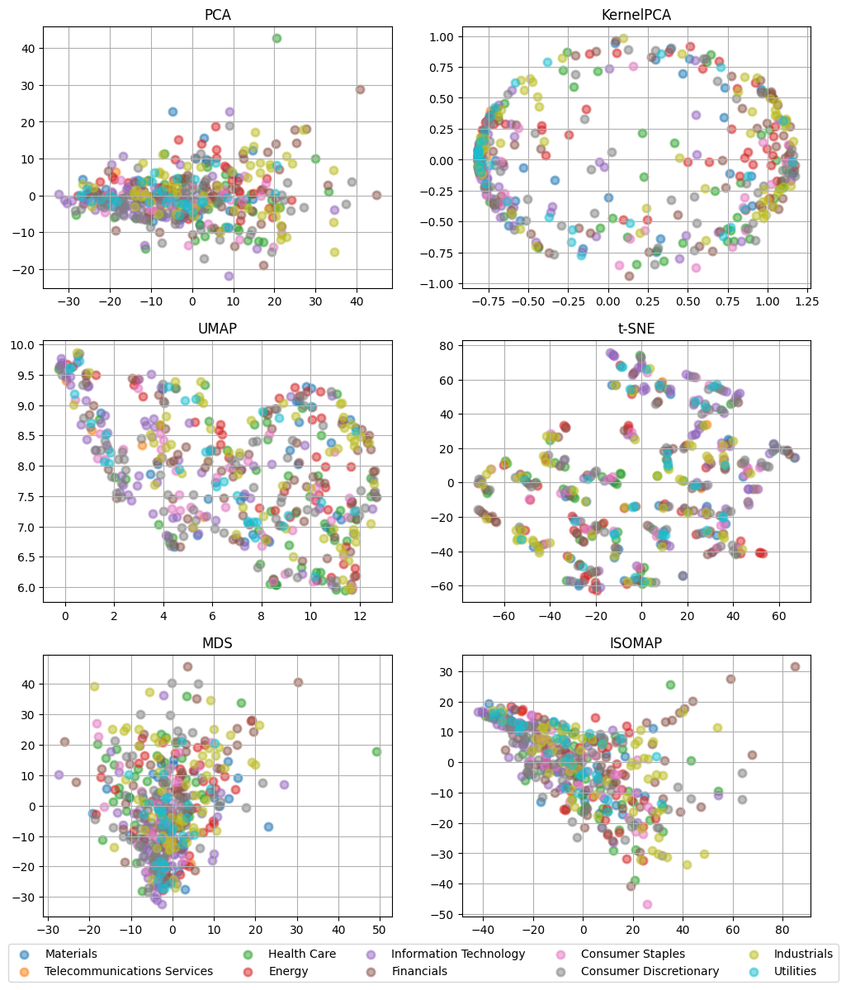
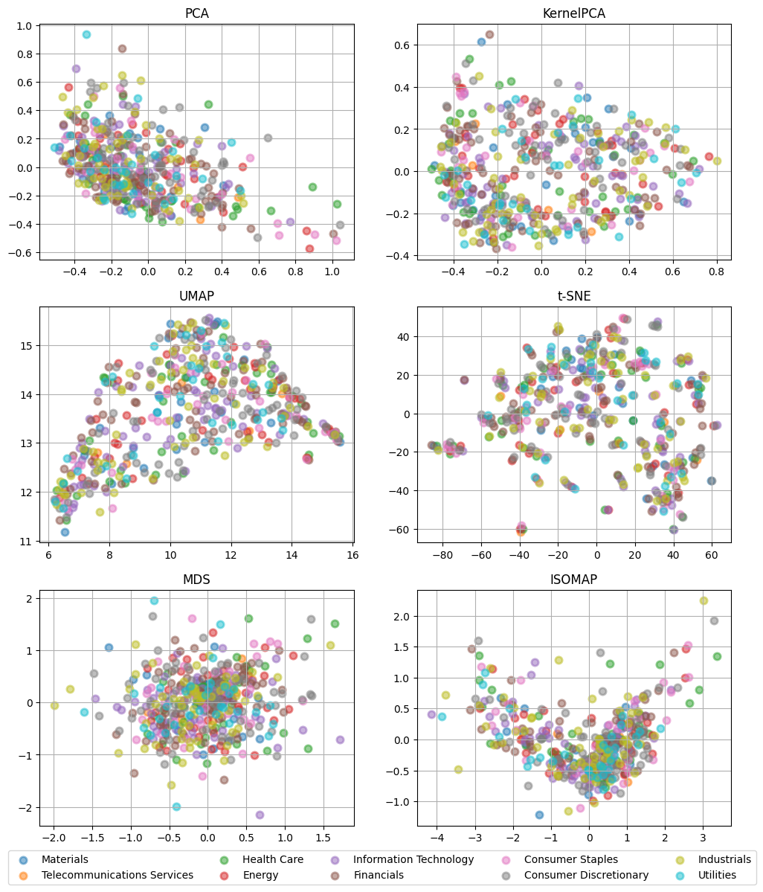
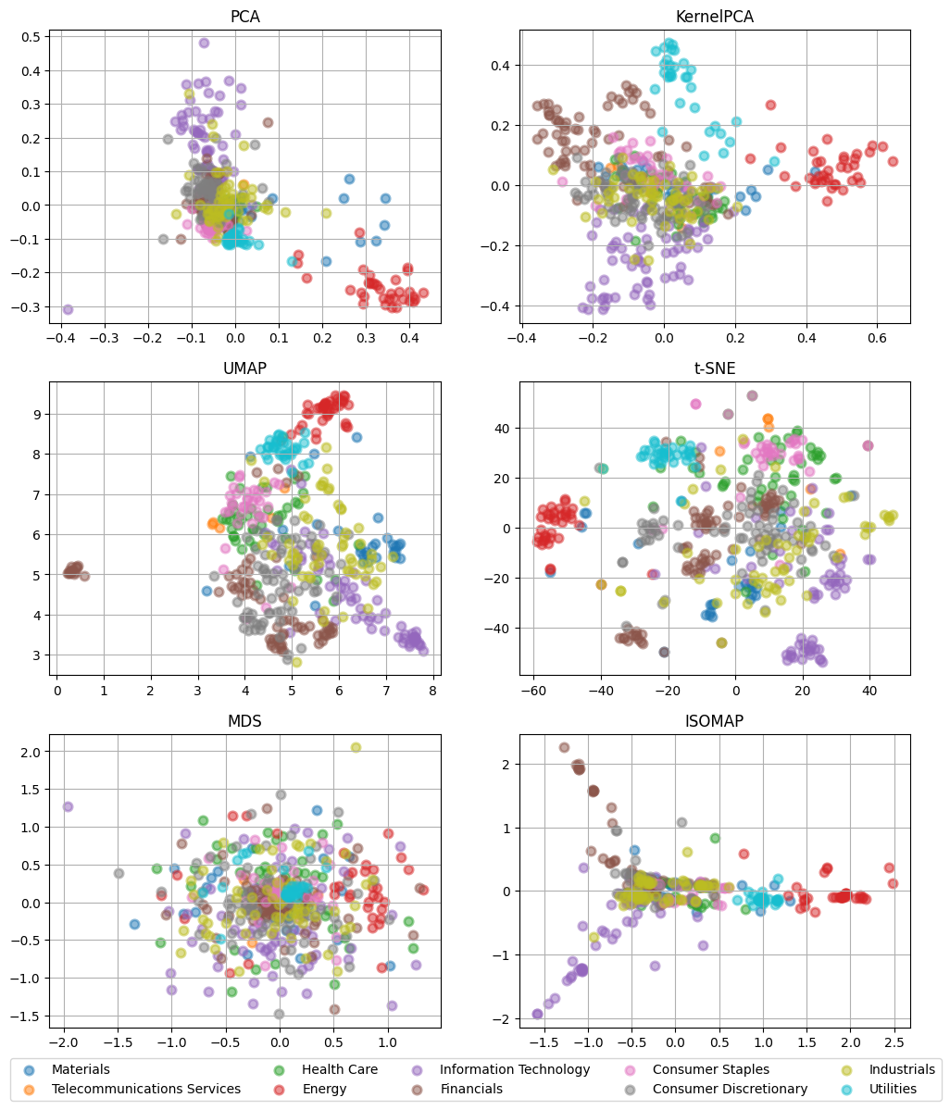
Visualization
For the data visualization, we employed dimensionality reduction, including PCA, kernel PCA, UMAP, t-SNE, MDS, and ISOMAP, on the row data, extracted features, and log return.
Visualization Experimental Results
Fig 1. Results of dimensionality reduction on raw data
Fig 2. Results of dimensionality reduction on features of each time series
Fig 3. Results of dimensionality reduction on log return of each time series
Math5473

Slide 10
Visualization
For the data visualization, we employed dimensionality reduction, including PCA, kernel PCA, UMAP, t-SNE, MDS, and ISOMAP, on the row data, extracted features, and log return.
Analysis
Visualizations based on log returns provided more meaningful insights and clearer patterns.
The effects of differing scales among various stocks was mitigated by converting price data into log returns.
The dimensionality reduction techniques focus on the relative changes in price rather than absolute differences, leading to more consistent visualizations.
Math5473

Slide 11
Outline
Introduction
Data Preprocessing
Visualization
Clustering
Topological analysis exploration
Conclusion
Math5473

Slide 12
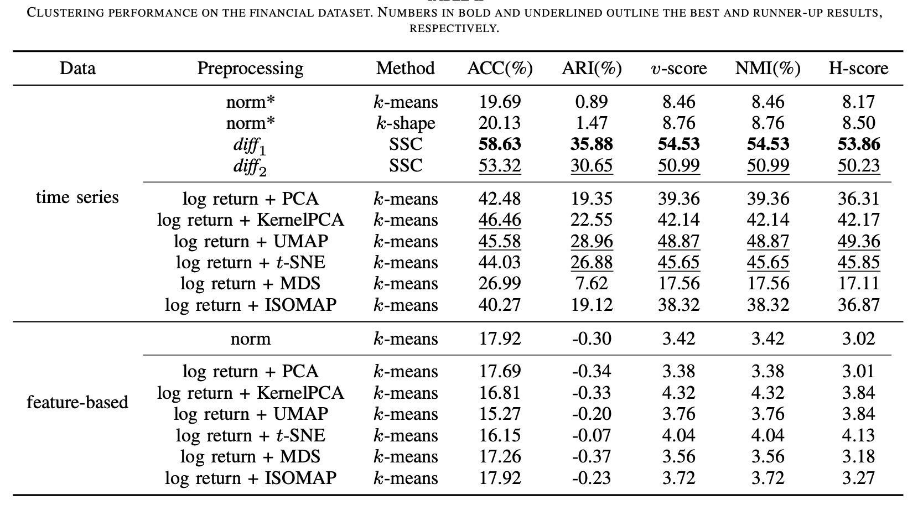
Clustering
For clustering time-series data, we employed k-means and k-shape, as well as the high-dimensional approach known as sparse subspace clustering (SSC).
Clustering Experimental Results
Table 1. Clustering performance on the financial dataset. We utilize different preprocessing techniques mainly categorized into time-domain representation and feature-based presentations prior to applying clustering. Number in bold and underlined outline the best and runner-up results, respectively.
Math5473

Slide 13
Clustering
Analysis
Combining log return representations with dimensionality reduction methods yields favorable performance.
Surprisingly, the SSC technique with first-order differentiation achieves the highest level of performance.
Conversely, feature-based and high-dimensional representations demonstrate poor performance.
Math5473

Slide 14
Outline
Introduction
Data Preprocessing
Visualization
Clustering
Topological Analysis Exploration
Conclusion
Math5473

Slide 15
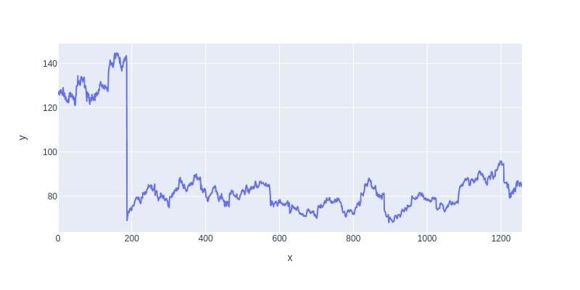
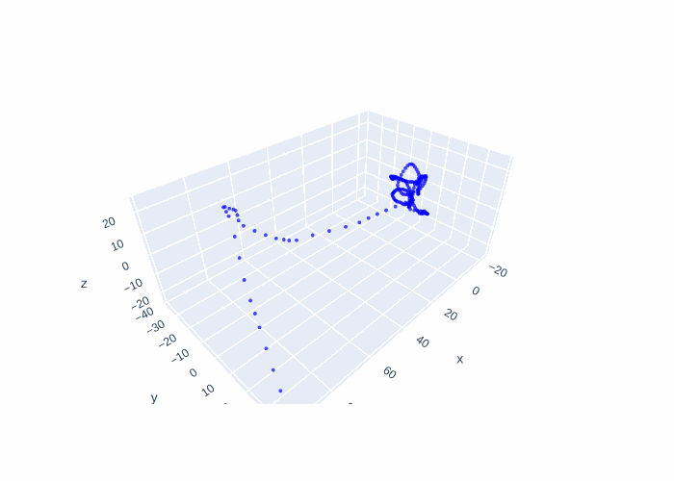
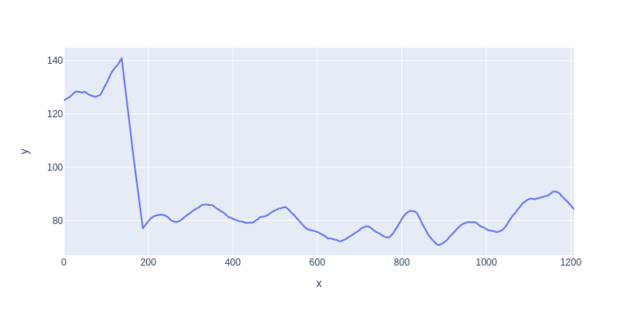
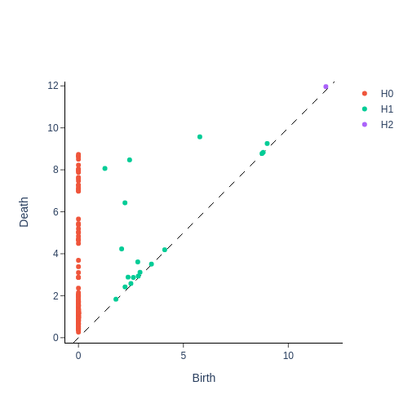
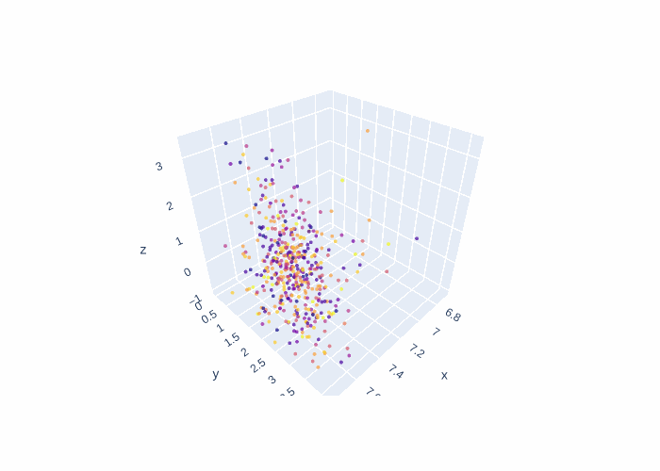
Topological Analysis Exploration
The time series data is generally challenging to visualize and cluster, we explored how to use TDA to analyze the time series data.
Takens embeddings
Vietoris-Rips filtration
Persistence diagram
PCA
Fig 4. Original and smoothed time series
Fig 5. Topological representation of time series
Persistence
Entropy
Fig 6. Persistence diagram from Vietoris-Rips filtration
Fig 7. Visualization of Persistence Entropy of dataset
Math5473

Slide 16
Outline
Introduction
Data Preprocessing
Visualization
Clustering
Topological analysis exploration
Conclusion
Math5473

Slide 17
Conclusion
Time-series data presents ongoing challenges, and our project has revealed the absence of a universally effective method.
The topological representation of time-series data enables the utilization of analysis methods that are fundamentally distinct in nature.
Whether using feature-based analysis, topological methods, or high-dimensional approaches, the selection of techniques must be tailored to each specific case when working with time-series data.
Math5473

Slide 18
Thank you!
Q&A
Math5473

